Slide 1
Genome 575: Fundamentals of Biomedical Instrumentation
Introductions
Name
Preferred pronouns
Science you are interested in
Where are you from
Fun Fact
Purpose of the Class … how it came to be
An introduction to the fundamentals of instrumentation commonly used in biomedical research settings including mass spectrometers, biochemical separations, optical microscopes, and DNA sequencers. Emphasis on a practical understanding of the physical and chemical properties that underlie operation and sources of uncertainty, noise, and error.

Slide 2
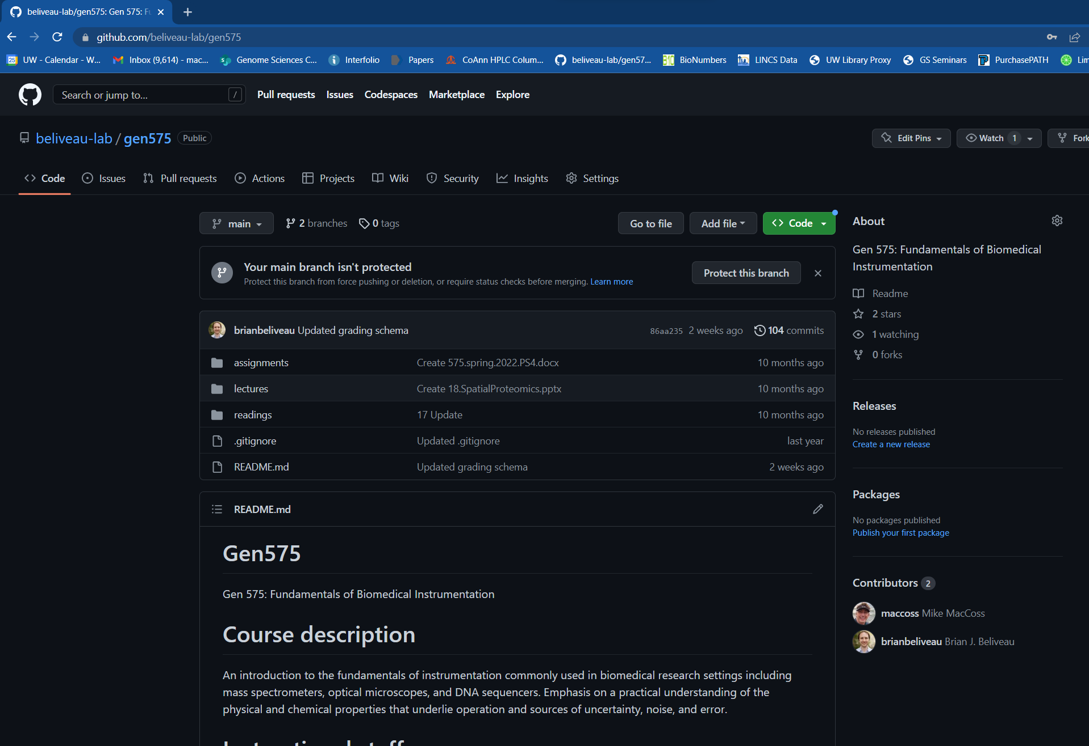
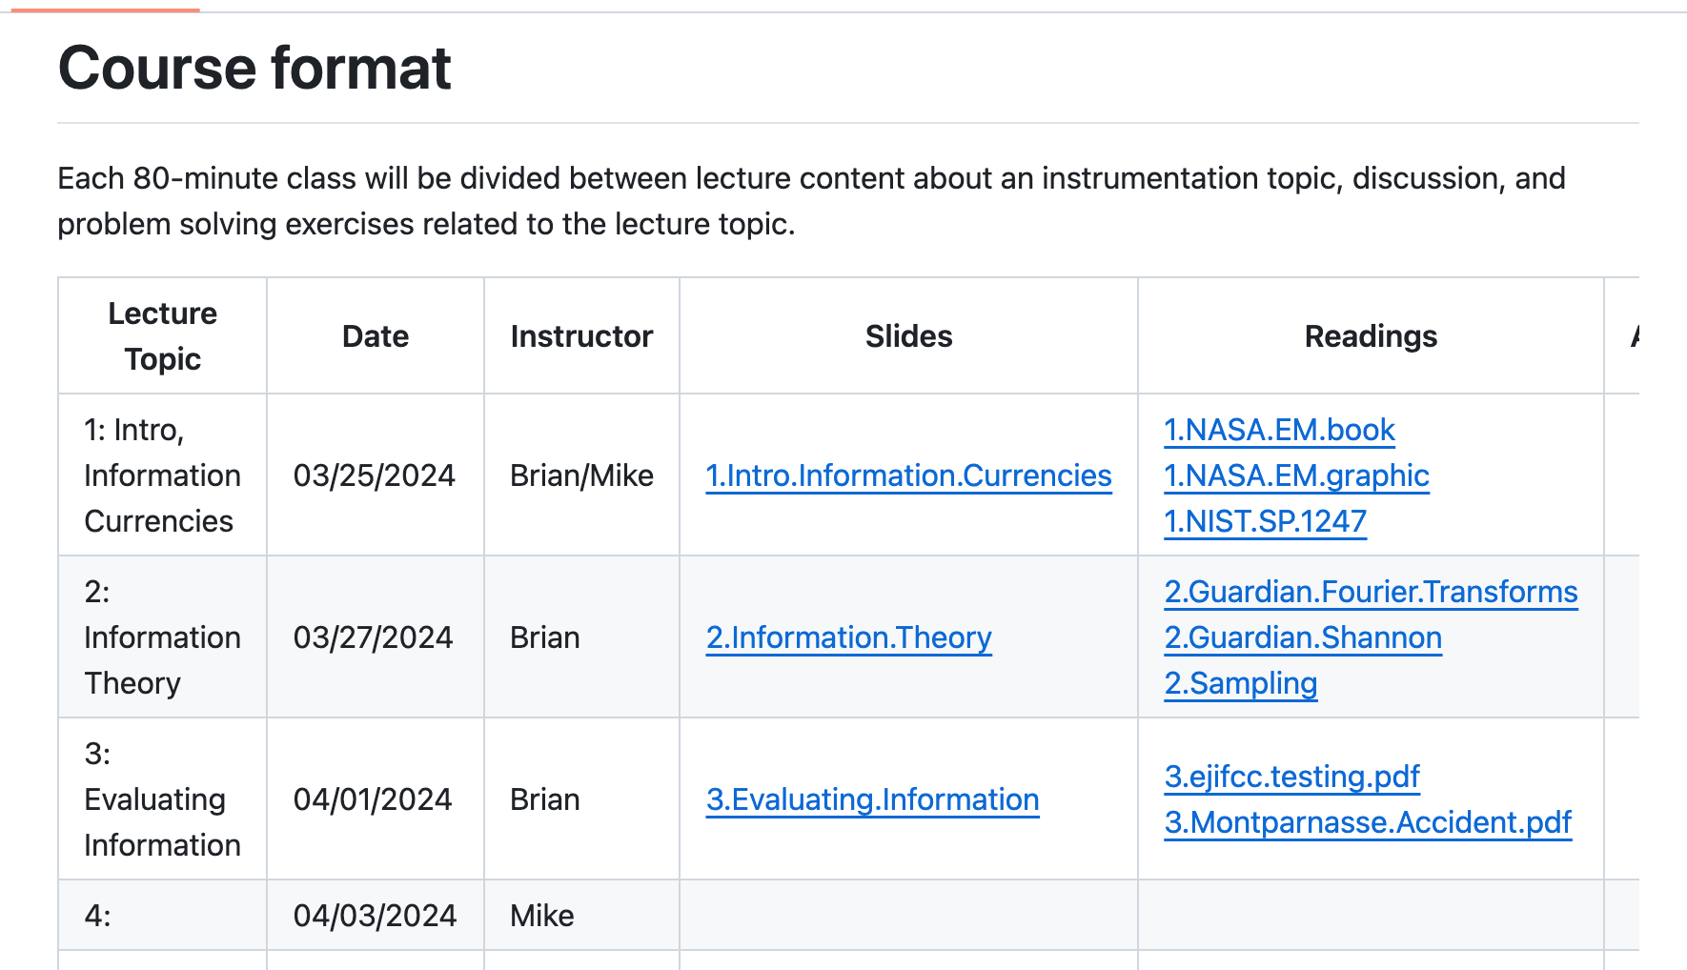
Website https://github.com/beliveau-lab/gen575

Slide 3
Grades:
Participation: 60%
Problem sets: 40% (4, worth 10% each)
Details:
Absence is ok but please let us know about travel and known absences in advance. Communicate illness and emergencies ASAP.
Late homework will be accepted but penalized (10% per day)

Slide 4
What you should expect
You should expect to be challenged!
There should be material that you know but also there should be material that we present that you don’t know.
You should expect to have a better fundamental understanding of the principles that define many biomedical instruments
There will be some topics presented multiple times during the class in different contexts and different ways.
You might even hear contradictory things from Mike/Brian
This year is the fourth time we have taught this class! There might be hiccups.

Slide 5
What we expect
We expect you to participate!
The more you participate the more we will all get out of the course.
Don’t hesitate to ask a question. If you have a question, it is almost certain that someone else has it too. Interrupt us.
We want feedback and to hear if content isn’t working.
We expect you all to come from different scientific backgrounds and interests.
We expect to learn from you!

Slide 6
Information Currencies
Genome 575: Fundamentals of Biomedical Instrumentation
Brian Beliveau

Slide 7
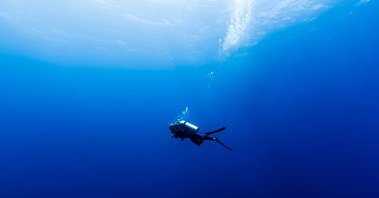
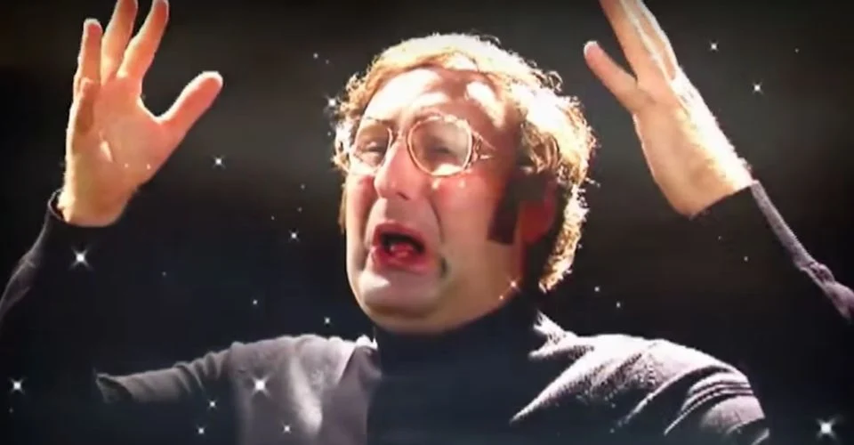
Goals for this class
Think about instruments in new ways
Dive deep
New angles
Gain a better of understanding of what is being measured and how it can mislead you
https://www.istockphoto.com/photo/scuba-diving-in-the-wild-blue-yonder-in-french-polynesia-gm484092196-71525013
https://static1.srcdn.com/wordpress/wp-content/uploads/2020/11/tim-and-eric-mind-blown.jpg?q=50&fit=crop&w=960&h=500&dpr=1.5

Slide 8
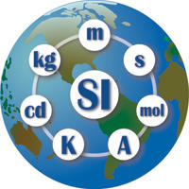
Le Systeme International d'Unites (SI)
Foundation of the metric system
Built on 7 base units + 7 associated constants. Assumed to be “mutually independent” (2019)
Many derived units
https://www.nist.gov/sites/default/files/styles/480_x_480_limit/public/images/2016/11/01/si-globe-logo.jpg?itok=9Z03oUtF

Slide 9

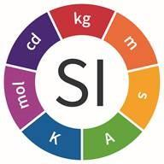
A guided tour of the SI base units
https://media.istockphoto.com/photos/travel-to-europe-tourist-looking-at-map-on-the-street-summer-holidays-picture-id1020217050?k=20&m=1020217050&s=612x612&w=0&h=7ldikMFS5XidjVHwYMnMRnfhXrSdqA3WRdUKkLYelIw=

Slide 10
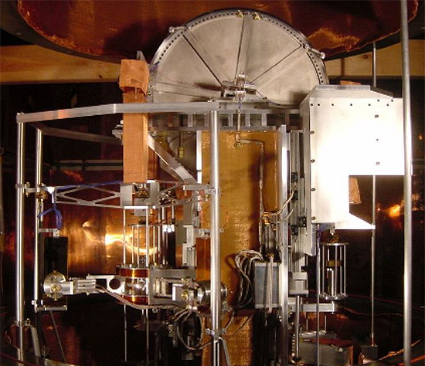
Kilogram (kg) : a unit for massive calculations!
Measurable: Mass
The quantity of matter in a physical body
Inertial mass: resistance to changes in velocity
Gravitational mass: defines strength of interaction with gravitational fields (weight)
Constant: h, 6.62607004 × 10⁻³⁴ m² kg / s
Planck’s constant
Energy = h * frequency
https://upload.wikimedia.org/wikipedia/commons/a/af/Watt_balance%2C_large_view.jpg
Kibble Balance

Slide 11
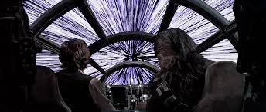
Meter (m) : a unit for lengthy journeys!
Measurable: Length
A measure of distance in a dimension
Constant: c, 299,792,458 m / s
Speed of light in a vacuum
s defined based on the Cesium standard (more soon!)
https://www.google.com/url?sa=i&url=https%3A%2F%2Fstarwars.fandom.com%2Fwiki%2FLightspeed%2FLegends&psig=AOvVaw2JW1S6KFHyEllGYWRdSznb&ust=1648597525352000&source=images&cd=vfe&ved=0CAsQjRxqFwoTCIiJgdL-6fYCFQAAAAAdAAAAABAD

Slide 12
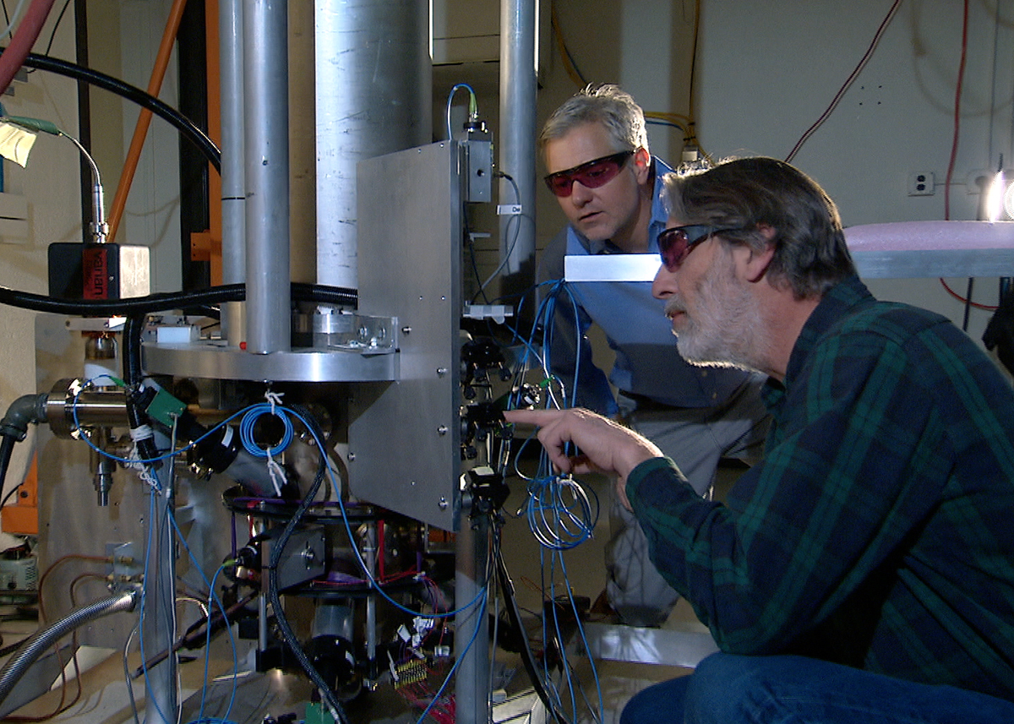
Second (s) : a unit for timeless experiences!
Measurable: Time
A measure of duration
Constant: ∆ν_{Cs}, 9,192,631,770 s⁻¹
A measure of the frequency of the relaxation of Cs133 (Spin F = 4) to Cs133 (F = 3)
https://upload.wikimedia.org/wikipedia/commons/4/43/NIST-F2_cesium_fountain_atomic_clock.jpg
“Atomic clock”

Slide 13
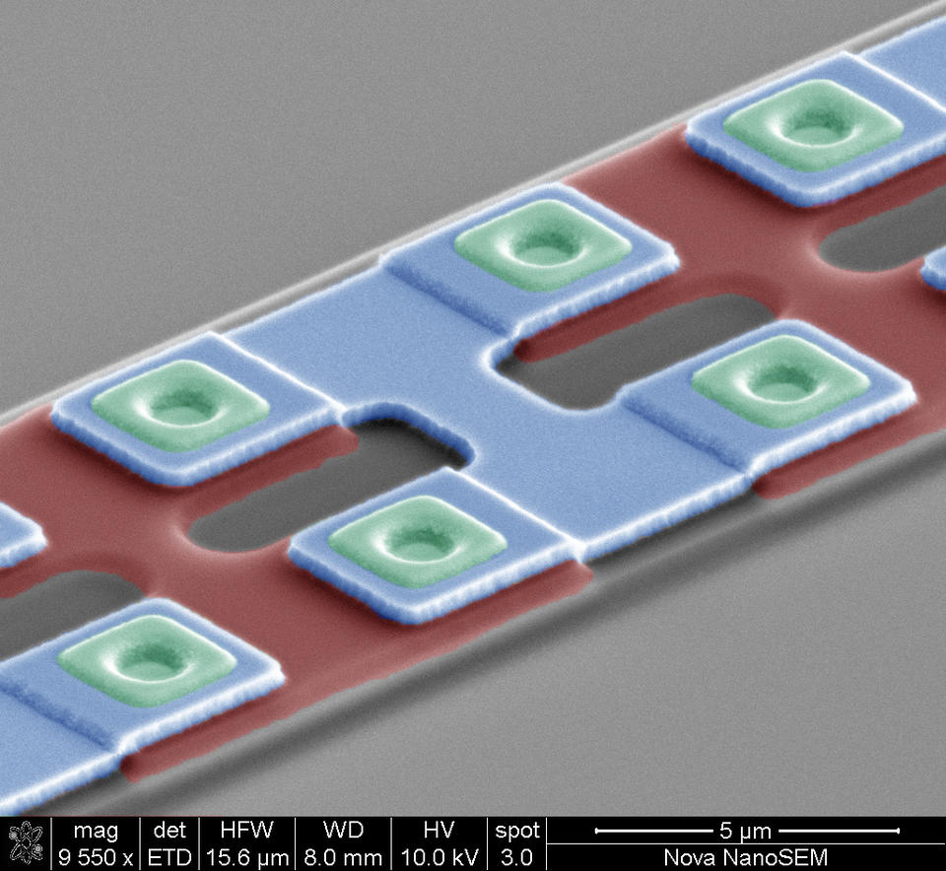
Ampere (A) : a unit for shocking discoveries!
Measurable: Electric current
A measure of charge flow through a conductor or space
Constant: e, 1.602176634 × 10⁻¹⁹ coulombs
Elementary charge (proton⁺ / electron⁻)
1 coulomb = 1 A * 1 s
The value of e depends on h (via Ohm’s law V = IR and measures of V, R), ∆ν_{Cs}
https://www.nist.gov/sites/default/files/styles/960_x_960_limit/public/images/2017/08/31/JJ-9550x-60deg_002_colored.jpg?itok=SKo9MpkM
Josephson junction (measures V)

Slide 14
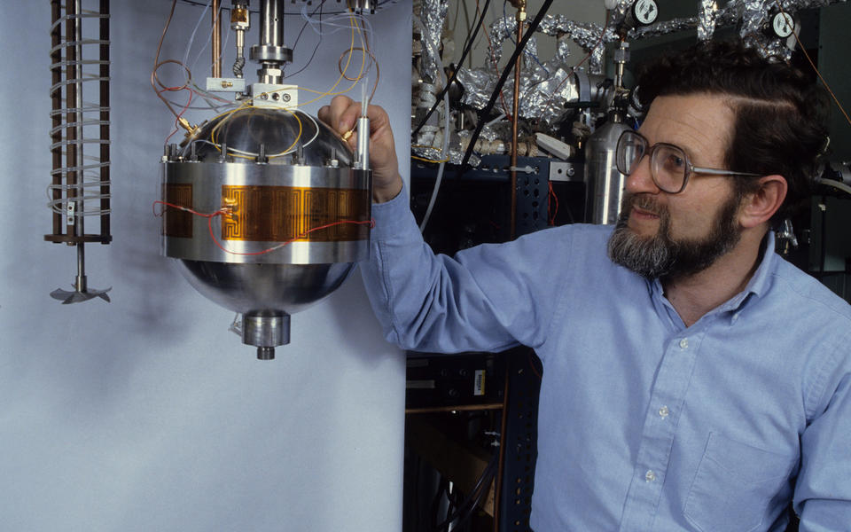
Kelvin (K) : a unit for heartwarming events!
Measurable: Temperature
A measure of thermal energy
Constant: k, 1.380649×10⁻²³ J / K
Boltzmann constant
1 joule (J) = 1 (kg * m²) / s²
k was measured empirically using an “acoustic resonator”
https://www.nist.gov/sites/default/files/styles/960_x_960_limit/public/images/2017/12/20/mike_and_gas_constant_resonator_img002_resized.jpg?itok=N4xGI-nI

Slide 15
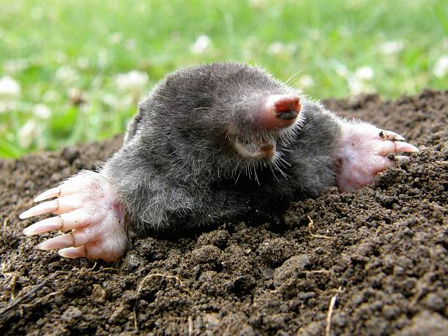
Mole (mol) : a unit for numerous possibilities!
Measurable: Amount of substance
A measure of how many elementary entities of a given substance are in an object/sample
Constant: N_{A}, 6. 02214076 x 10²³ particles / mol
Avogadro’s number
Value set by the International Bureau of Weights and Measures
https://www.google.com/url?sa=i&url=https%3A%2F%2Fwww.istockphoto.com%2Fphotos%2Fmole-animal&psig=AOvVaw3-kGEh5rmx2g4bcchmx9k_&ust=1648749197129000&source=images&cd=vfe&ved=0CAsQjRxqFwoTCMDImcWz7vYCFQAAAAAdAAAAABAD

Slide 16
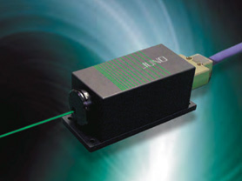
Candela (cd) : a unit for illuminating analyses!
Measurable: Luminous intensity
A measure of luminous power per unit solid angle (ie, some FOV) emitted by a point light source
Constant: K_{cd}, 683 lumens / W
Based on the luminous efficacy of monochromatic radiation of frequency 540 × 10¹² Hz (~555 nm)
FWIW in optics we just use W
https://www.ksoc.co.jp/en/seihin/lasers/img/dpss.jpg

Slide 17
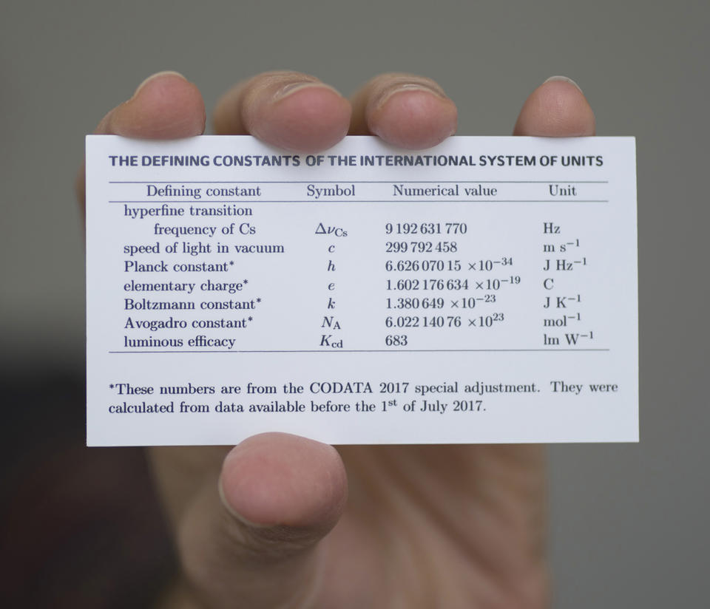
Can’t get enough of the SI constants?
https://www.nist.gov/sites/default/files/styles/960_x_960_limit/public/images/2018/10/30/17pml015_si-constants-card.jpg?itok=Ecezgy_j

Slide 18
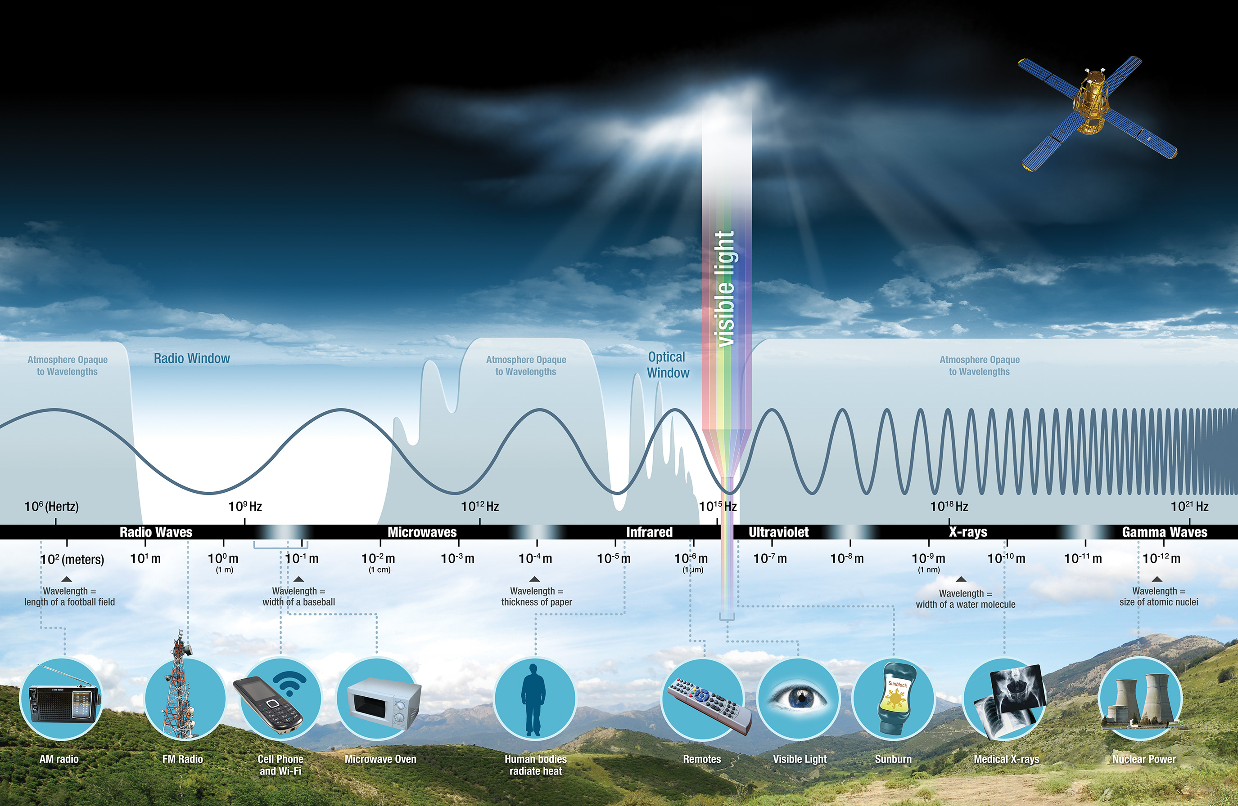
Electromagnetic radiation
What is your favorite part of the EM spectrum?
https://science.nasa.gov/files/science-pink/s3fs-public/styles/science_news_hero_image/public/thumbnails/image/intro-1.jpg?itok=iRsuB2Q7

Slide 19
Electromagnetic radiation
Wavelength (𝝀) = c (velocity) / frequency (f)
Greater f == more energy
https://science.nasa.gov/files/science-pink/s3fs-public/styles/science_news_hero_image/public/thumbnails/image/intro-1.jpg?itok=iRsuB2Q7

Slide 20
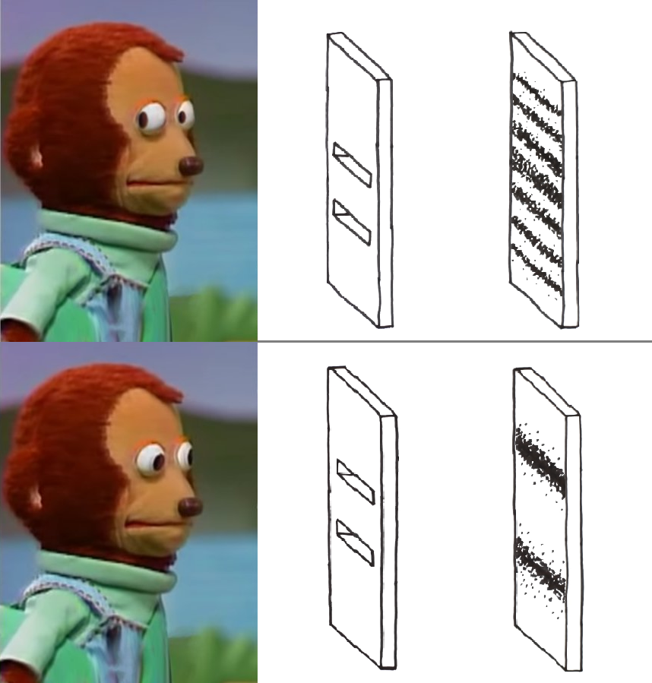
What is going on here?
https://i.redd.it/pz6s3irlge861.png

Slide 21
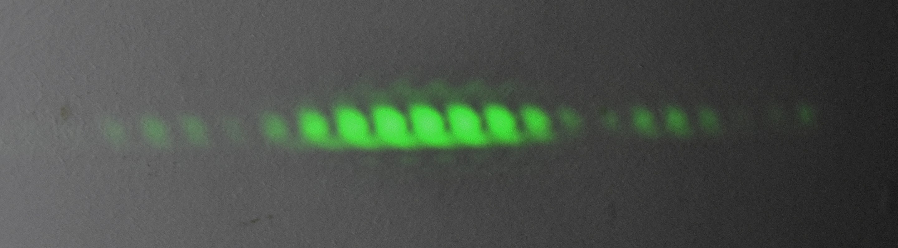
Wave-particle duality
Light waves interfere with each other -> diffraction pattern
Place a detector at a slit, diffraction pattern disappears (!!)
Electromagnetic radiation behaves simultaneously as a wave and a particle (photon)
https://i.redd.it/pz6s3irlge861.png, https://upload.wikimedia.org/wikipedia/commons/thumb/3/39/Young%27s_slits.jpg/2880px-Young%27s_slits.jpg, https://static1.srcdn.com/wordpress/wp-content/uploads/2020/11/tim-and-eric-mind-blown.jpg?q=50&fit=crop&w=960&h=500&dpr=1.5

Slide 22
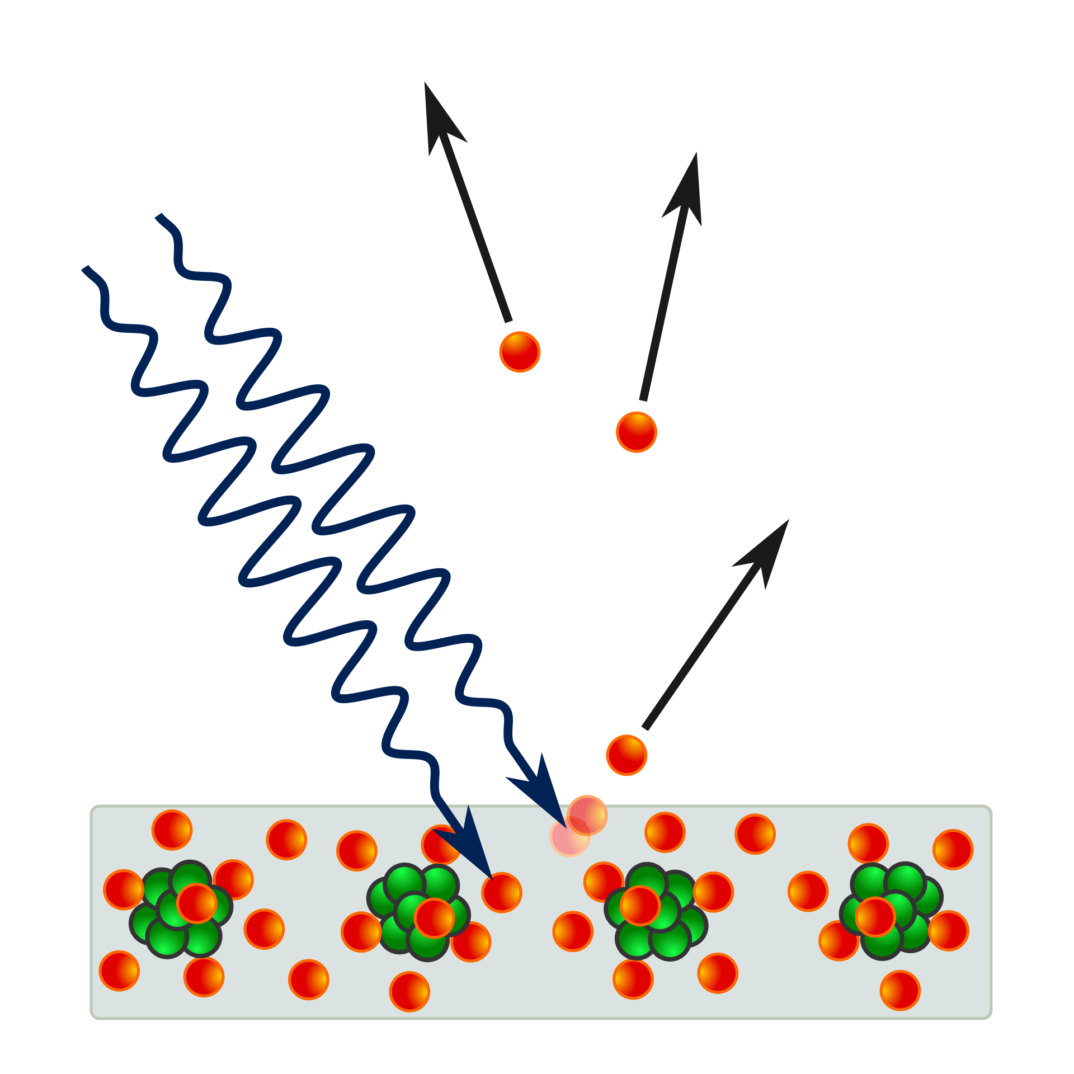
Photoelectric effect
EM radiation (photons) in, (photo)electrons out
Energy of incident EM must be above a threshold, dependent only on f
E = h * f
https://upload.wikimedia.org/wikipedia/commons/thumb/a/a6/Photoelectric_effect_in_a_solid_-_diagram.svg/1920px-Photoelectric_effect_in_a_solid_-_diagram.svg.png

Slide 23


Trivia time!
Teams of 2–3 (card draw)
Phones and computers away
https://i2.wp.com/www.evolvedcontact.com.au/articles/wp-content/uploads/2020/04/81-817751_quiz-time-announcement-poster-neon-signboard-vector-quiz.png?fit=1024%2C417&ssl=1, https://scuffedentertainment.com/wp-content/uploads/2021/03/pub-trivia-quiz.jpg

Slide 24
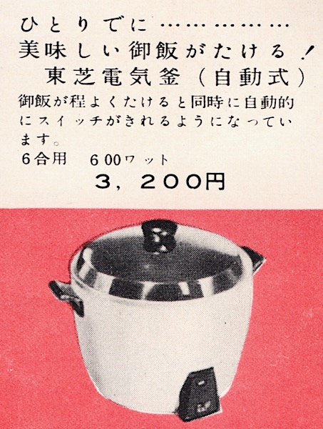
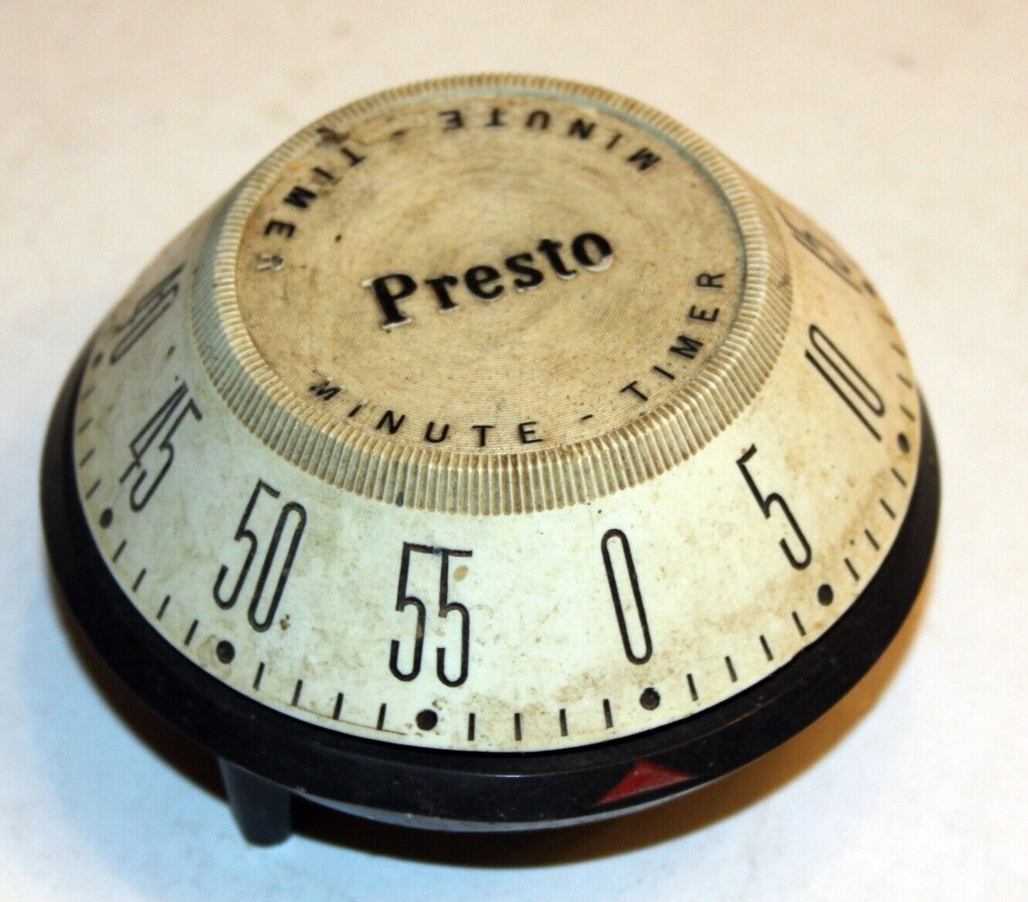
Question 1 (10 mins)
Toshiba ER-4
1956: 700 units/year
1970: 12.3M units/year
98ºC, 20 mins
Why not? And then how?
https://en.wikipedia.org/wiki/Rice_cooker#/media/File:Electric_Rice_Cooker_1956.jpg

Slide 25
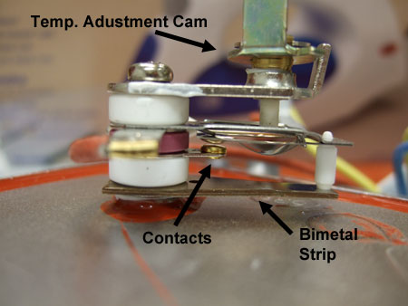
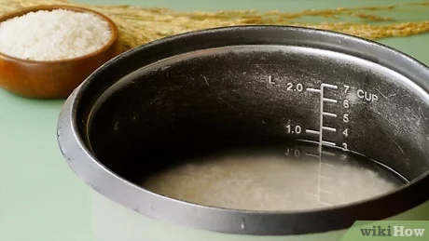
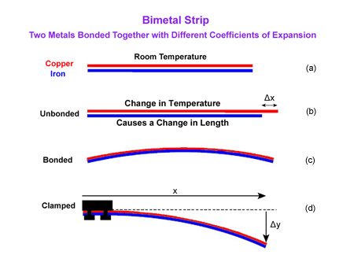
Answer 1
Time to reach boiling unpredictable
Time at 98ºC predicable
Bimetallic thermostat senses when the temperature of the bottom of the pan >100ºC
Senses temperature (via e⁻) as a proxy for time
https://m.media-amazon.com/images/I/61ZOy1oalYL._AC_SL1500_.jpg, https://upload.wikimedia.org/wikipedia/commons/thumb/c/c3/StrainGaugeVisualization.svg/1024px-StrainGaugeVisualization.svg.png

Slide 26
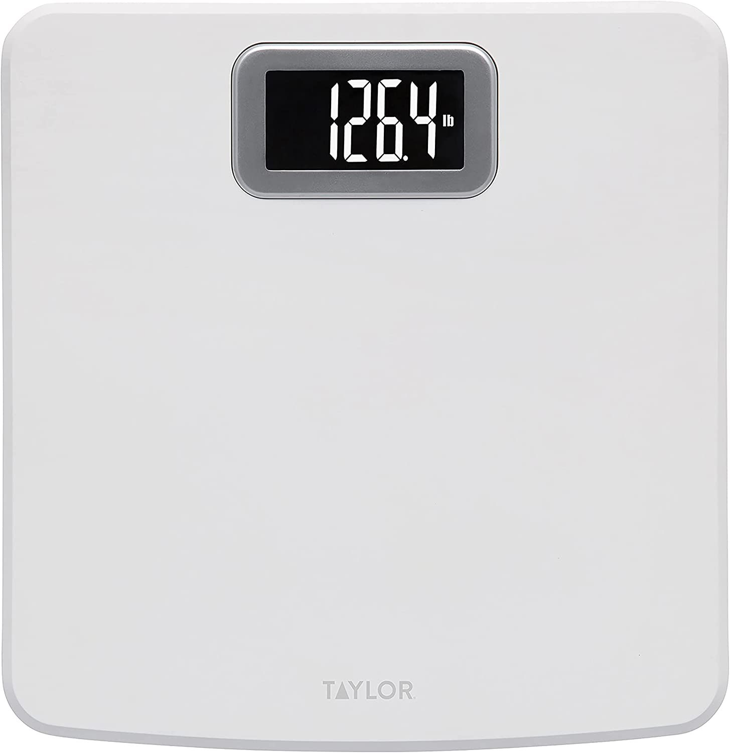
Question 2 (10 mins)
Digital bathroom scale
What does this actually measure?
https://m.media-amazon.com/images/I/61ZOy1oalYL._AC_SL1500_.jpg

Slide 27
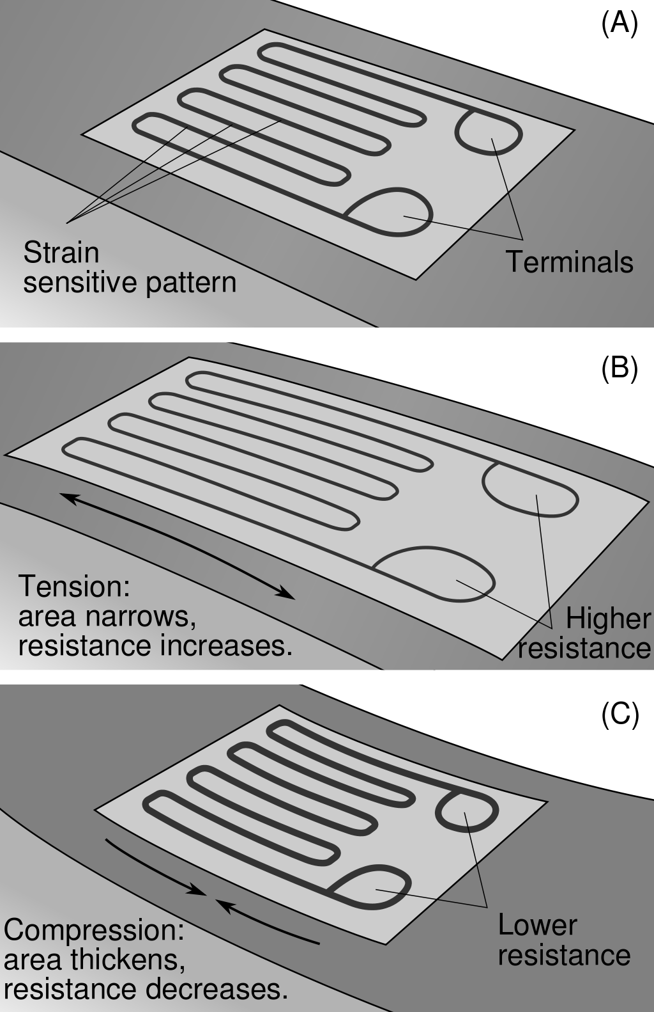
Answer 2
A strain gauge changes electrical resistance (R) as a function of deformation
Changes in R are converted to digital units
Approach relies on calibration
https://m.media-amazon.com/images/I/61ZOy1oalYL._AC_SL1500_.jpg, https://upload.wikimedia.org/wikipedia/commons/thumb/c/c3/StrainGaugeVisualization.svg/1024px-StrainGaugeVisualization.svg.png

Slide 28
Concept: transducers
Strain gauges are examples of transducers
Transducers convert energy from one form to another
Here: weight (kg * g) in, ∆R (V / A) out
SI base units: kg → A
https://m.media-amazon.com/images/I/61ZOy1oalYL._AC_SL1500_.jpg, https://upload.wikimedia.org/wikipedia/commons/thumb/c/c3/StrainGaugeVisualization.svg/1024px-StrainGaugeVisualization.svg.png

Slide 29
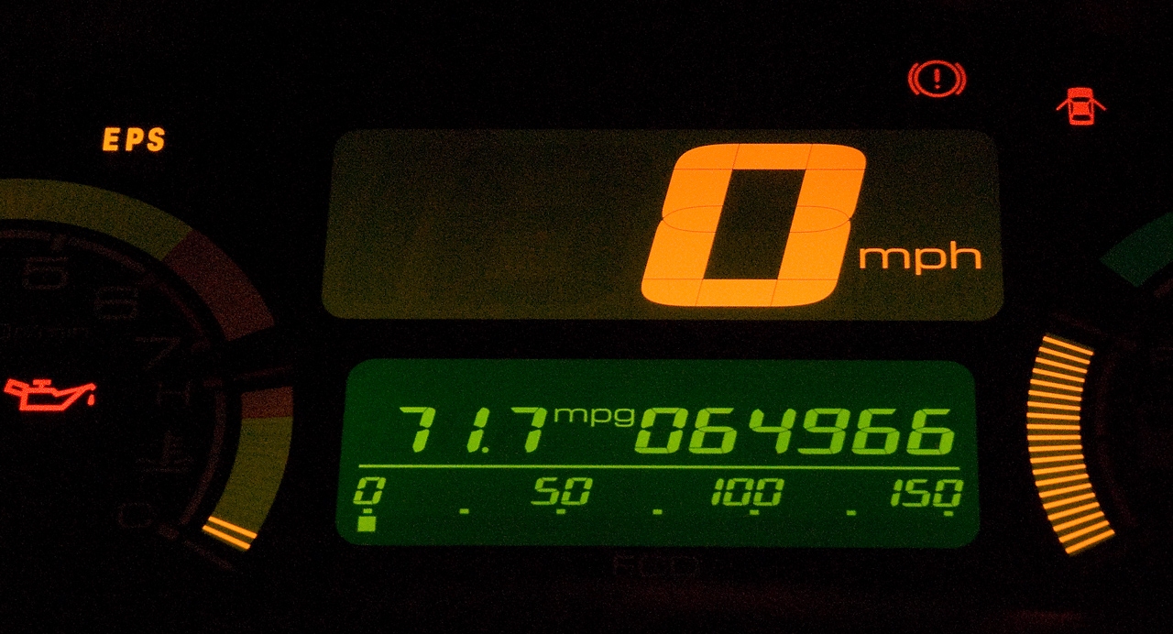
Question 3 (10 mins)
Car speedometer
What does this actually measure?
https://upload.wikimedia.org/wikipedia/commons/c/cb/717mpg.jpg

Slide 30
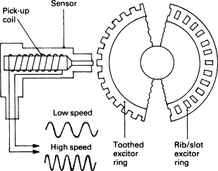
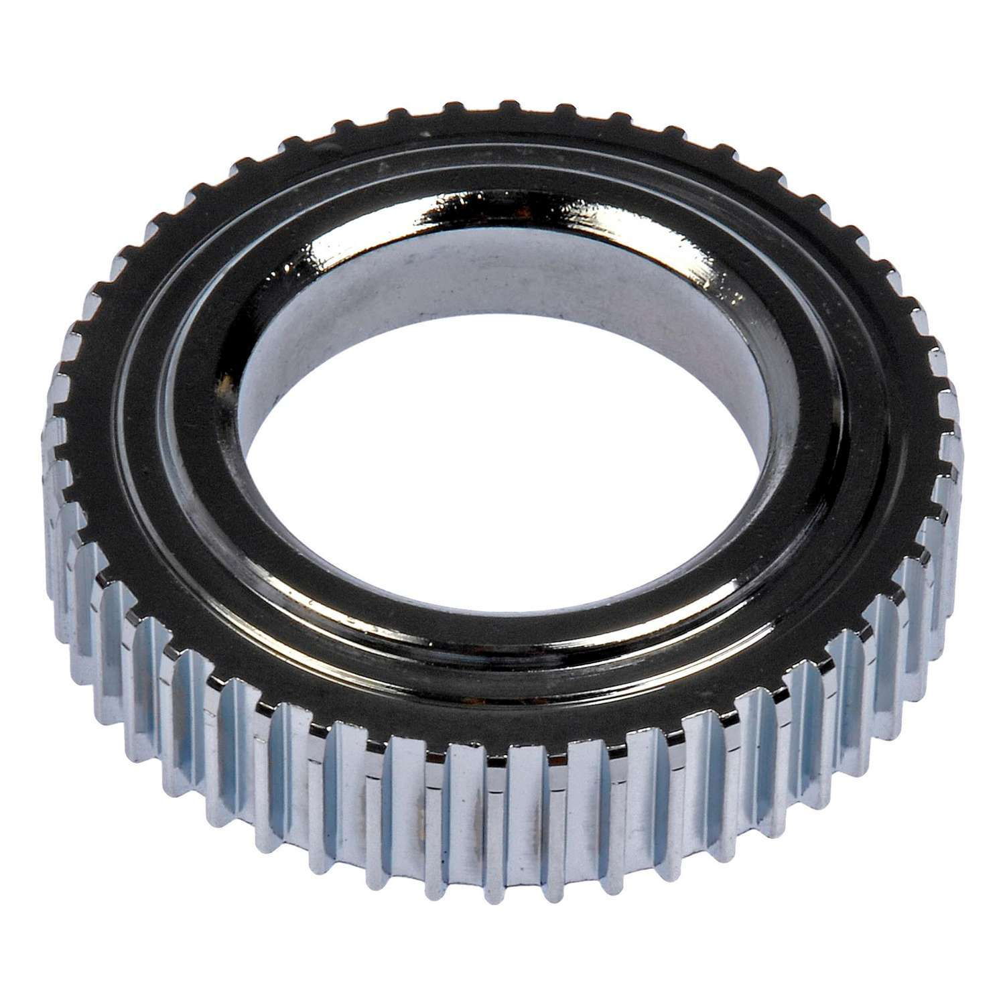
Another conversion
Velocity is desired readout
Angular velocity of driveshaft/axel a proxy
Velocity (m / s) in, V (Ω * A) out
SI base units: (m / s) → A
Tone wheel
https://ars.els-cdn.com/content/image/3-s2.0-B9780750651318500129-f11-40-9780750651318.gif, https://i5.walmartimages.com/asr/4fbb556a-dcde-46fe-88f7-dc4da8676bdb.736184df7fa4885998187990b6299827.jpeg

Slide 31
Answer 3
Ferromagnetic toothed ring spins with axel or drive shaft
Sensor contains electromagnet
Teeth distort magnetic field -> creates alternating electrical field
Changes in spin speed -> changes in f of alternating V
Approach relies on calibration
Tone wheel
https://ars.els-cdn.com/content/image/3-s2.0-B9780750651318500129-f11-40-9780750651318.gif, https://i5.walmartimages.com/asr/4fbb556a-dcde-46fe-88f7-dc4da8676bdb.736184df7fa4885998187990b6299827.jpeg

